Slide 1
COMPARATIVE ANALYSIS
SELECTION AND IMPLEMENTATION OF AN ALGORITHM FOR OPTIMIZING SYSTEM

Slide 2
INTRODUCING DATASET FOR COMPARING VARIOUS APPLICATIONS
Position Level Salary
Business Analyst 1 45000
Junior Consultant 2 50000
Senior Consultant 3 60000
Manager 4 80000
Country Manager 5 110000
Region Manager 6 150000
Partner 7 200000
Senior Partner 8 300000
C-level 9 500000
CEO 10 1000000
We have a dataset representing salaries of it professional’s at different - different levels..
Using this set of data I am going to compare multiple machine learning algorithm's and then
We will decide which one should be implemented
For making model which offer highest efficient
Predictions.

Slide 3
BUISNESS UNDERSTANDING :
All around the globe there are various organizations ,which works for different-
Different purposes but each and every sector has its own hierarchy of ranks
Of professional’s and there respective salary ,here I am trying to built a simple
Machine learning model which predict salary corresponding to its rank..
Actual usecase: while appointing some newcomer’s or any experience at any position other than those we are already clear off,as mentioned in list
From 1 to 10 levels we have ,if we are going to appoint any person at any
Meanwhile position than what would be salary for them …
Keeping in mind those ranks for which salary is already mentioned …
TARGET We are going to built this model using different _different ml algo’s and considering ,
Results of all of them we will built most optimized model here.. Meanwhile understanding implementation of various ml algo’s and there comparision.

Slide 4
*****Working with linear regression*****
Linear Regression is a supervised machine learning algorithm where the predicted output is continuous and has a constant slope. It’s used to predict values within a continuous range, (e.g. sales, price) rather than trying to classify them into categories (e.g. cat, dog). There are two main types:
Simple regression
Simple linear regression uses traditional slope-intercept form, where mm and bb are the variables our algorithm will try to “learn” to produce the most accurate predictions. xx represents our input data and yy represents our prediction.
y=mx+by=mx+b
Multivariable regression
A more complex, multi-variable linear equation might look like this, where ww represents the coefficients, or weights, our model will try to learn.
f(x,y,z)=w1x+w2y+w3zf(x,y,z)=w1x+w2y+w3z
The variables x,y,zx,y,z represent the attributes, or distinct pieces of information, we have about each observation. For sales predictions, these attributes might include a company’s advertising spend on radio, TV, and newspapers.
Sales=w1Radio+w2TV+w3News

Slide 5
Working with polynomial regression…
In statistics, polynomial regression is a form of regression analysis in which the relationship between the independent variable x and the dependent variable y is modelled as an nth degree polynomial in x
When we should use polynomial regression?
It should be used when there is no linear correlation between variables,

Slide 6
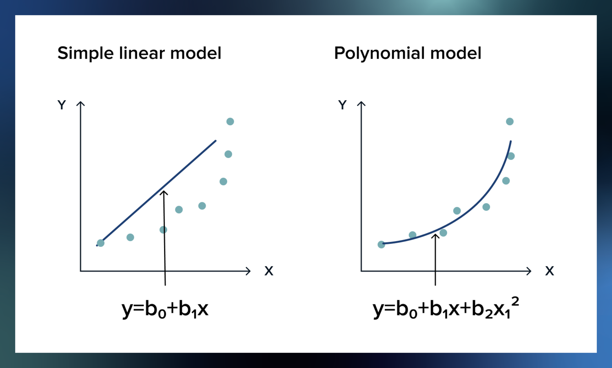

Slide 7
Explanation of code:
1>importing packages
2>reading dataset
3>identifying problem
4>splitting independent and dependent attributes.
5>importing linear regresser,building an object
6>fitting and transforming input dataset
Note: I have not split dataset into training and testing as working with smaller data ..
7>taking prediction from the model applying parameter and
Hyper paramerer tunnings.
8>visualizing results
9>comparing results obtained by various algorithems….
10>further minor details are well documented as comments in code itself.

Slide 8
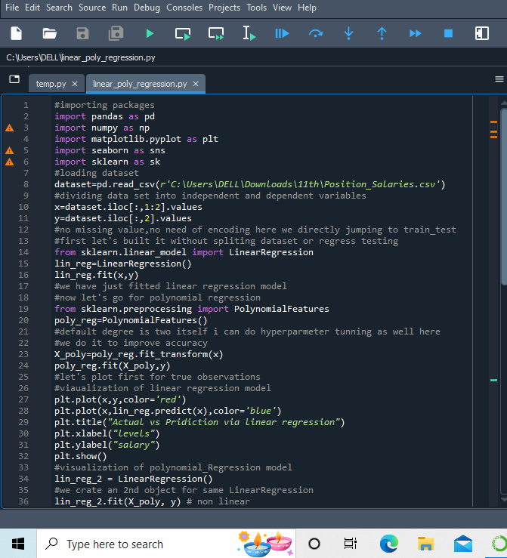

Slide 9
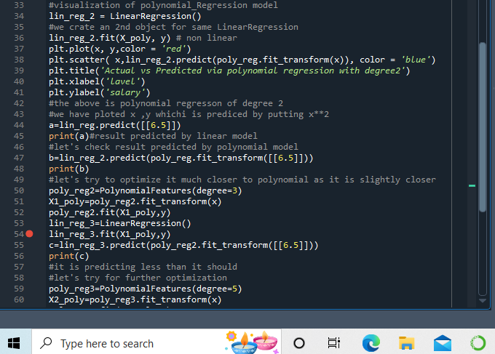

Slide 10
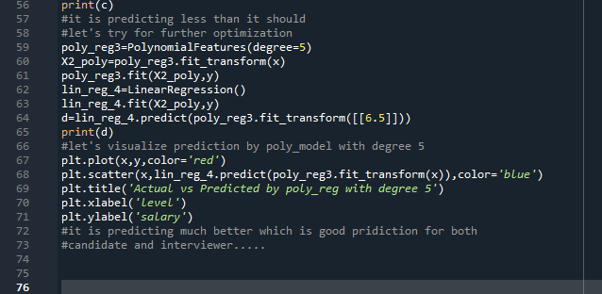

Slide 11
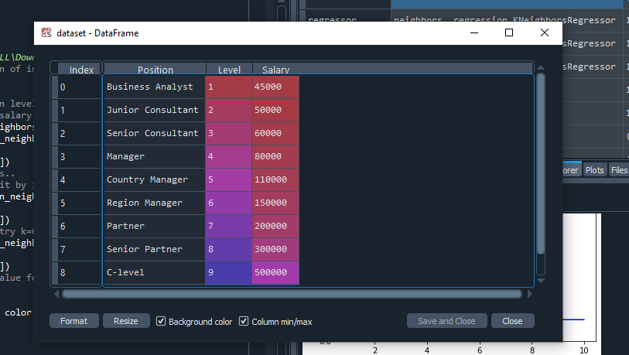
This is dataset,,we are working on in spyder …

Slide 12
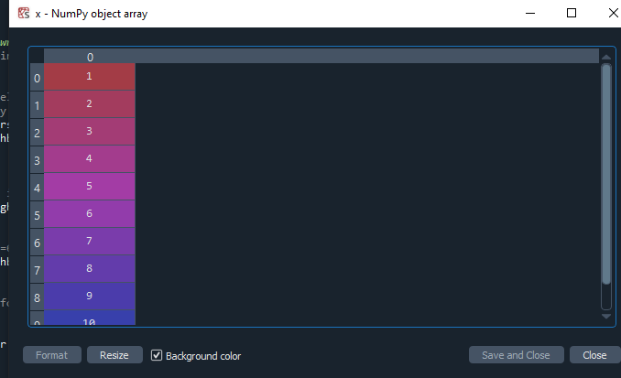
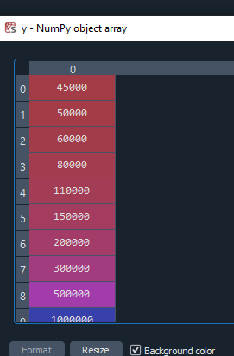
This is x ,independent variable (levels)
This is dependend variable y(salary)

Slide 13
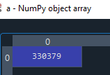
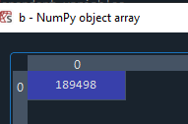
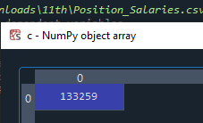
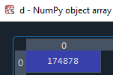
here are the results!
THROUGHT THE PROJECT I WILL TRY TO PREDICT
SALARY FOR LEVEL 6.5
USING DIFFERNET ML ALGO’S
AS COMPARISON SHOULD BE CLEAR THEREFORE
I HAVE USED SAME INPUT THROUGHT THE CODE
Results from linear regression:
Results from polynomial regression

Slide 14
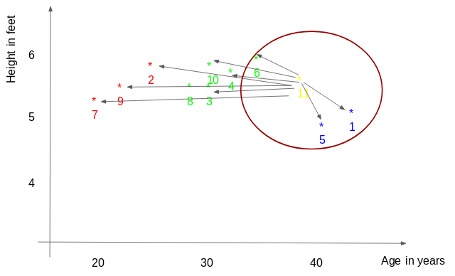
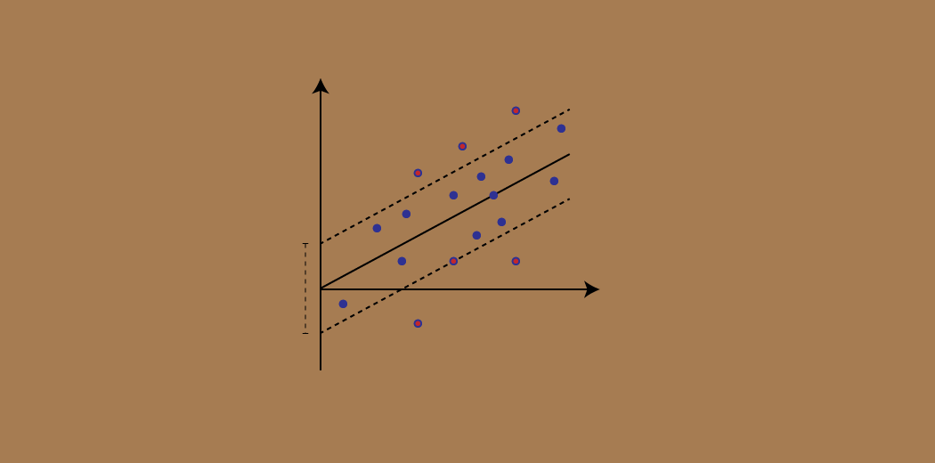
Working with KNN and SVR
Support vecter regresser
k-nearest neighbour
SVR acknowledges the presence of non-linearity in the data and provides a proficient prediction model.

Slide 15
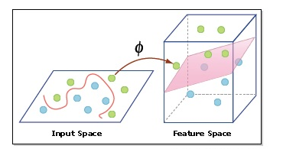
Kernel: A kernel helps us find a hyperplane in the higher dimensional space without increasing the computational cost. Usually, the computational cost will increase if the dimension of the data increases. This increase in dimension is required when we are unable to find a separating hyperplane in a given dimension and are required to move in a higher dimension:

Slide 16
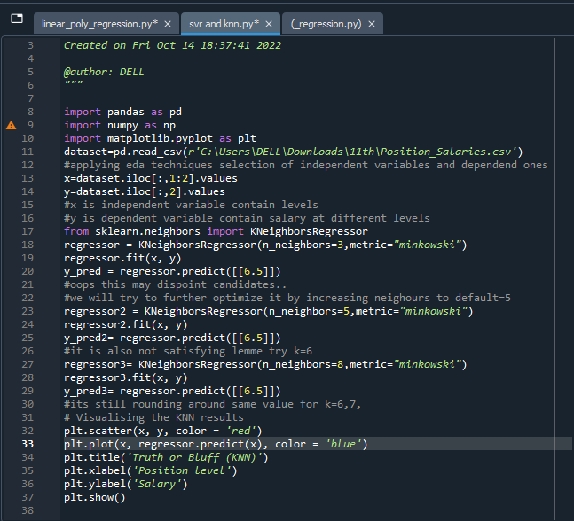

Slide 17
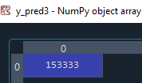
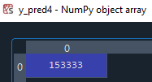
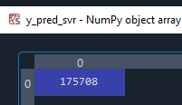
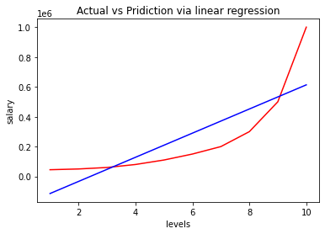
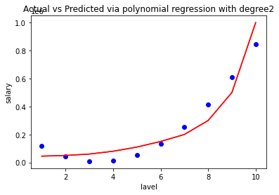
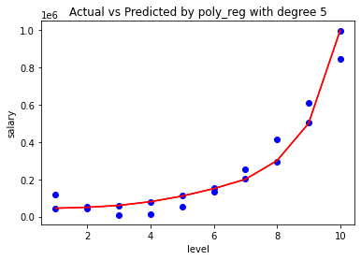
Predicted by knn regression
Predicted by svr

Slide 18
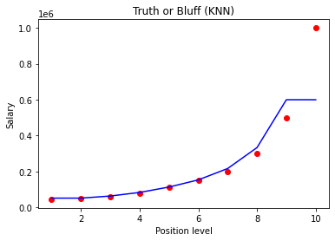
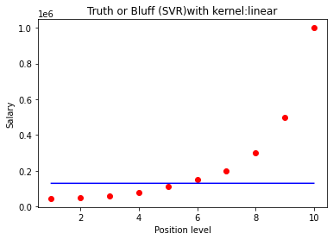
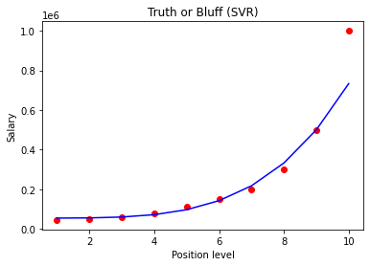

Slide 19
regression | prediction | hpt1 | hpt2 | hpt3
Linear regression | 330379
Polynomial regression | 189498 | 133259 | -------------- | 174878
knn | 153333 | 153333 | 153333
svr | 175708

Slide 20
THANK YOU
CREATED BY AMBALI ANJANE

